Slide 1
Software Product Management Business plan
Nandagopal Govindan

Slide 2
Contents
Purpose of business plan
Contents of a business plan
What investors look for
Example: Airbnb pitch

Slide 3
Purpose
The business plan is a tool to think through different aspects of our business, identify issues and remedial measures.
It is also used to secure finance from Venture capitalists.

Slide 4
Contents of a business plan: Typical
Executive summary
Product & its value
Market size
Competition
Marketing strategy
Operational plan
People strength
Financial forecasts
Key risks & mitigation plan
Conclusion Appendices

Slide 5
Product & its value
Product-Market-fit
Customer segment
Problem / Under-served need
Solution / Value proposition
Goal (SMART)
Example:
To be the most children-centric provider of online stories in the next 5 years
Achieve a C-Sat rating of 4.5 / 5 in 5 years

Slide 6

Market size
Available market and addressable market (people to whom you can reach out to and serve)
Example:
Instrument to help throat cancer patients to speak after their throat surgery.
30,000 patients a year are diagnosed with cancer of the larynx in India
(
Dr. Vishal Rao
https://www.bbc.com/news/business-41969801
https://www.thebetterindia.com/41251/dr-vishal-rao-affordable-voice-prosthesis/

Slide 7
What is the market size for
Online children stories
Online library of BE student books
Product recommendation & consulting business

Slide 8
Competition
Who are the competitors
Their revenue
Their Growth
Their Strategy – main focus of their strategy, pricing policy, sales pitch

Slide 9
Who are the competitors who impact the addressable market?
Online children stories
Online library of BE student books
Product recommendation & consulting business

Slide 10
Marketing strategy
Different aspects of marketing strategy:
Create awareness about the product (Ex. Press release, SEO)
Create a set of high profile reference customers (Ex. Kissflow)
Differentiate on quality, simplicity, price, service

Slide 11
What would be your marketing strategy for:
Online children stories
Online library of BE student books
Product recommendation & consulting business

Slide 12
Operational plan
Product development plan
Release milestones
Service and support plan

Slide 13
What is your release plan for
Online children stories
Online library of BE student books
Product recommendation & consulting business

Slide 14
What is your customer support & service plan for
Online children stories
Online library of BE student books
Product recommendation & consulting business

Slide 15
People strength
Experience of Management staff
Management experience
Domain knowledge
Experience of Technical staff
Experience of Marketing staff

Slide 16
What type of skills & resources do you need to develop this product?
Online children stories
Online library of BE student books
Product recommendation & consulting business

Slide 17
Financial forecast
Sales forecast
Break-even analysis
Profit & loss projections
Cash flow projections
Balance sheet forecast

Slide 18
Sales forecast
Year | # of customers | Revenue ($)
2021 | 1,000 | 10 Million
2022 | 3,000 | 30 Million
2023 | 10,000 | 100 Million

Slide 19
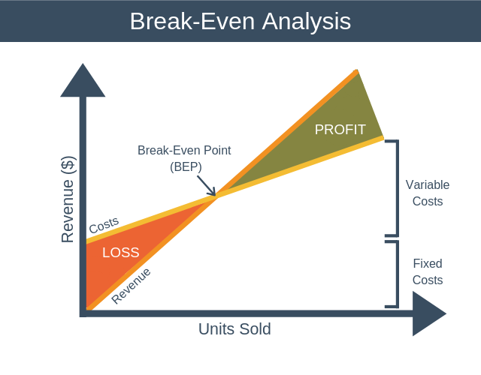

Slide 20
Example of break even

Slide 21
Exercise in Break even
What costs will we be incurring each year in developing and marketing this product?
Online children stories
Online library of BE student books
Product recommendation & consulting business

Slide 22
What revenues can we expect each year from this product?
Online children stories
Online library of BE student books
Product recommendation & consulting business

Slide 23
When will be reach break-even?

Slide 24
Profit & Loss statement
Sales revenue
less direct costs (labour, tools)
Gross profit
Gross margin (%)
less depreciation
less other overheads
Operating profit
Operating margin (%)
plus other income
EBIT (Earning before income & Tax)
less interest
PBT (Profit before tax)
less tax
PAT (Profit after tax, aka Net profit)
Net margin (%)
Gives an idea about the revenue, expenses and profit or loss for a period.

Slide 25
Cash flow statement
Cash flowing in | Cash flowing out
Receipt of cash from sales (may be delayed due to payment terms) Loans Equity proceeds (sale of equity) | Rent & infrastructure expenses Salaries Repayment of loan Purchase of equipment
Tells whether there is enough cash coming in to meet the expenses

Slide 26
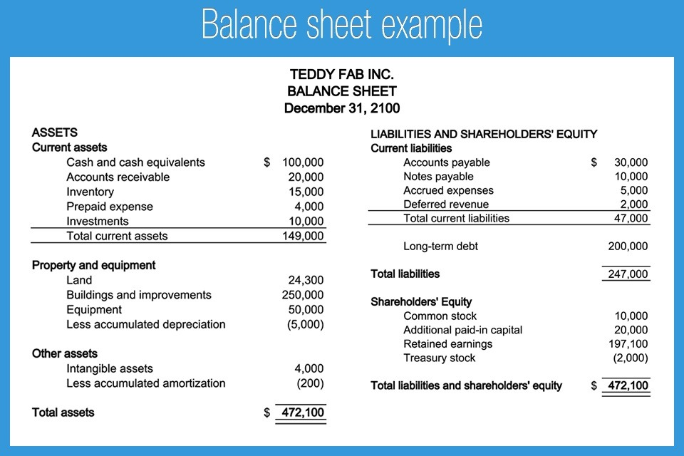
Talks about assets, liabilities and equity on a specific date

Slide 27
Risks and mitigation plan
What risks do you see in this product business?
Online children stories
Online library of BE student books
Product recommendation & consulting business

Slide 28
Risks and mitigation plan
How do you plan to address these risks?
Online children stories
Online library of BE student books
Product recommendation & consulting business

Slide 29
Risks & mitigation plan
Example
# | Risk | Impact | Probability | Score | Mitigation plan
1 | Competition may come up with a similar product | High (9) | Low (2) | 18 | Keep a close watch on the market Differentiate by addressing needs of a subset of the market
2 | We may need more number of iterations to prove MVP | Medium (5) | Medium (5) | 25 | Study the market deeper Identify 5-6 customers to work closely during MVP testing phase Create rough working models to save on time

Slide 30
What investors look for in the business plan
Is there real value in the product?
Is there a good growth potential?
Does the team have the ability to deliver?
Is the plan good enough?
Are the financial projections realistic?

Slide 31

Example Business plan: AirBnB
What are the strengths of this business plan?
How can this plan be improved?

Slide 32
Appendix

